Slide 1

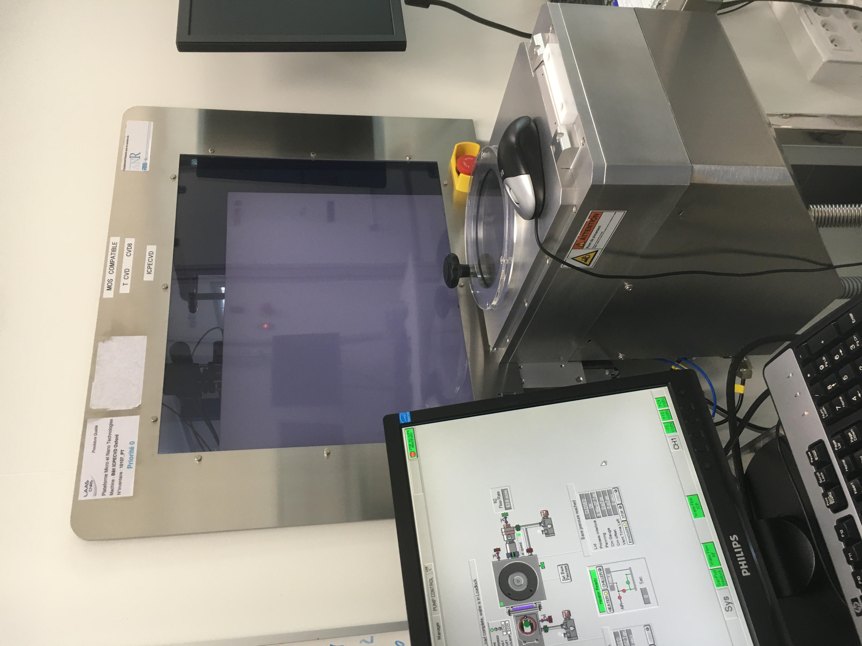
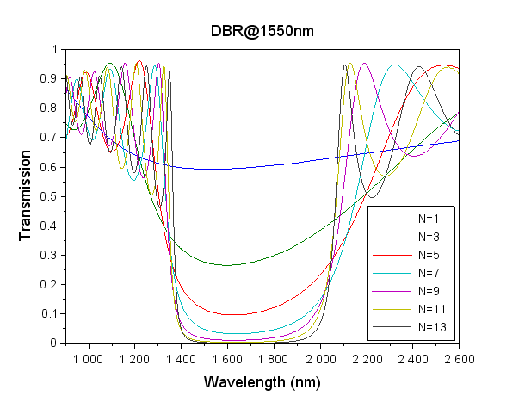
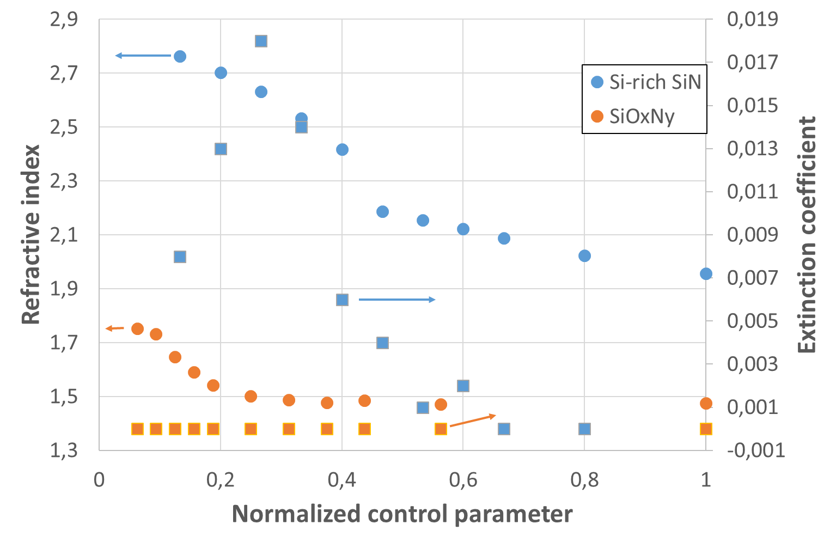
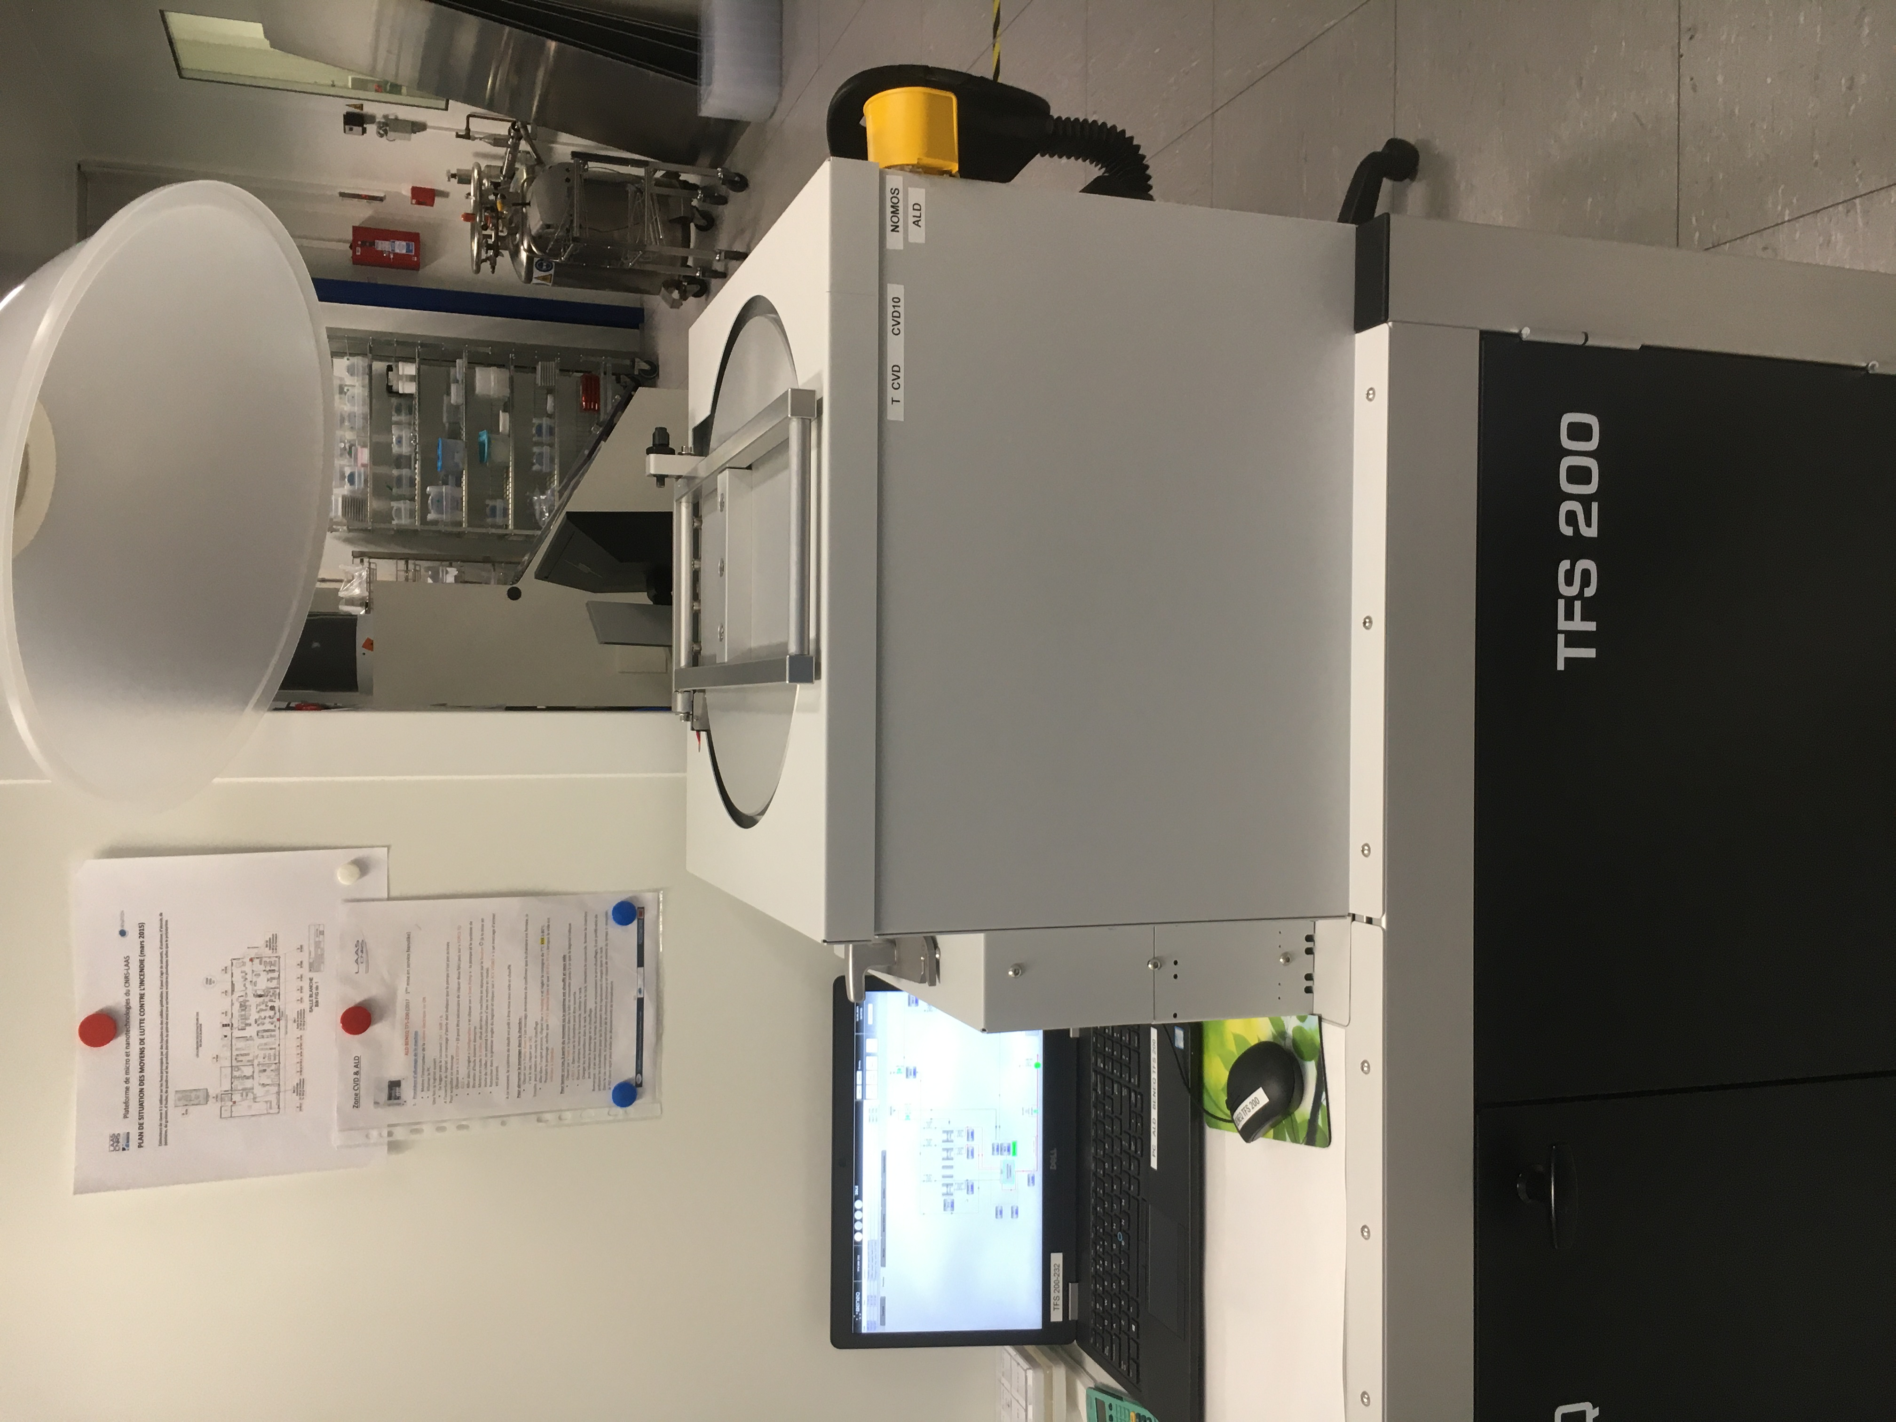
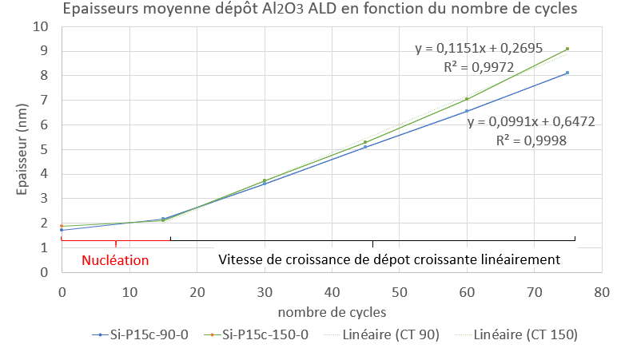
Clean room of LAAS : experiments on CVD, ALD
Example 1 : Refractive index in the fabrication of anti-reflective coatings at 775nm and optical mirrors at 1550 nm on fused silica.
Expert author(s) : XXXXXXXXXXXXXXXXXXXXXXXXXXXX
Objective(s) : linear and nonlinear refractive indexes for optical thin-films, coatings of interest for instance for (frequency-doubling) cavity-resonant integrated grating filters structures ^{1,2}
Parameters : SiH₄ , N₂O, N₂ and P_{icp}
by varying the flux of N₂O (up to 80 sccm)
keeping all other parameters constant
¹ F. Renaud, A. Monmayrant, S. Calvez, O. Gauthier-Lafaye, A.-L. Fehrembach, and E. Popov, Opt. Lett. 44, 5198 (2019).
² J.-B. Dory, O. Gauthier-Lafaye, P. Dubreuil, I. Massiot, S. Calvez, and A. Mlayah, Mater. Res. Express 9, 045006 (2022).
³ Stéphane Calvez^{1,*}, Pascal Dubreuil¹, Mairame Diallo¹, Emmanuelle Daran¹, Antoine Monmayrant¹, Olivier Gauthier-Lafaye¹ , JNTE (2024)
Acknowledgements : The authors would like to acknowledge partial support from the ANR ASTRID Reson (ANR-19-ASTR-0019), the Occitanie Region project “Dimension” (2018-003267) and from RENATECH, the French network of cleanroom facilities.
Request for experience or need for help at ENL-TF : ?????????
ICPECVD
First results ³ :
Drawback : ???
Transmission curves of the fabricated N-layer mirror coatings.
Example 2 : Deposition Al₂O₃ by ALD to form a conformal encapsulation layer around the thin layer of the spin transition complex.
Expert author(s) : XXXXXXXXXXXXXXXXXXXXXXXXXXXX
Objective(s) : The reversible change between the low-spin and high-spin electronic states can be induced by changes in temperature. Here the implementation of optical sensors or as a means of actuating components such as modulators.
Parameters : TMA, H₂O, cycle, pulse, T°
Lowing T° to 90°C and keeping all other parameters constant
¹ M. Drob, A. Hoblos*, J. A. Capo Chichi, P. Dubreuil, L. Salvagnac, L. Salmon*, G. Molnár*, K. Ridier*, A. Bousseksou* et S. Calvez, RAFALD (2024)
Acknowledgments: The work presented benefited from support from the ANR SCOPOL project (ANR-22-CE09-0019) and from the micro-technology center of LAAS-CNRS, a member of the French national network, RENATECH.
Request for experience or need for help at ENL-TF : ??????????
ALD
First results ¹ :
Modulation of the transmission at λ=315 nm demonstrating the phase transition
before and after encapsulation by ALD of a 400 nm layer of tri-azolyl iron borate with 50 nm of Al2O3.
Drawback : ???

